Slide 1
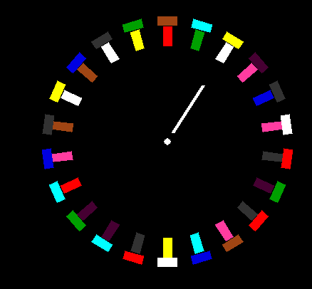





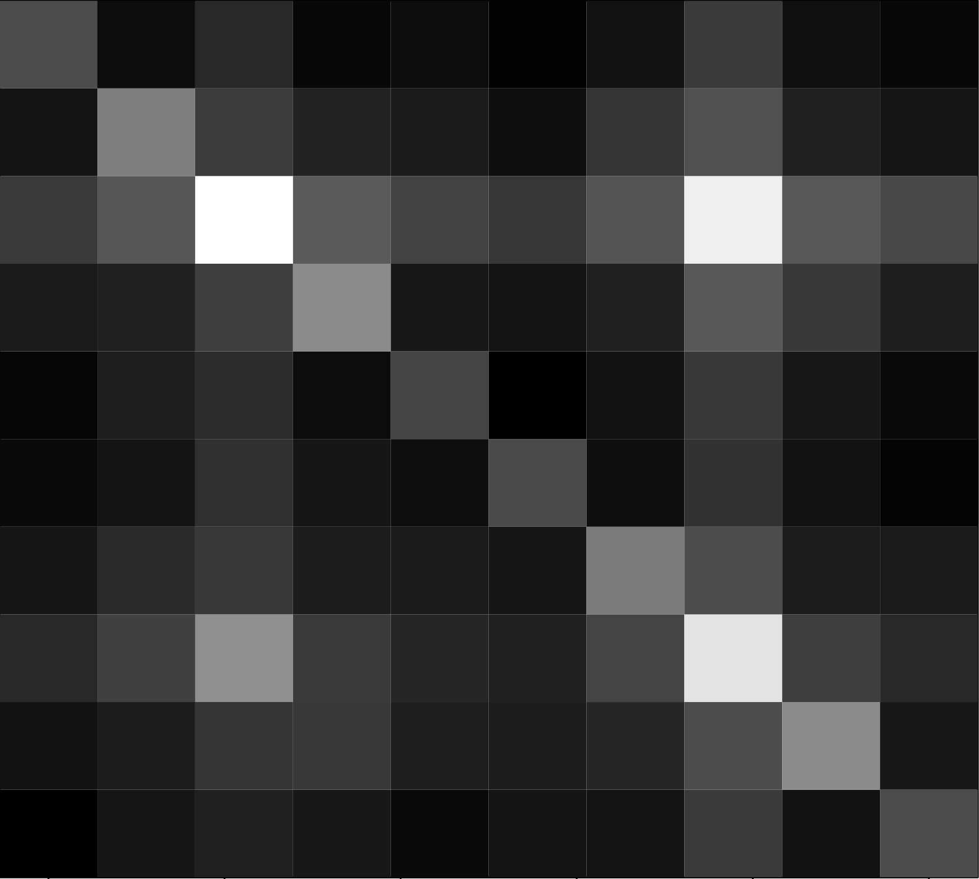
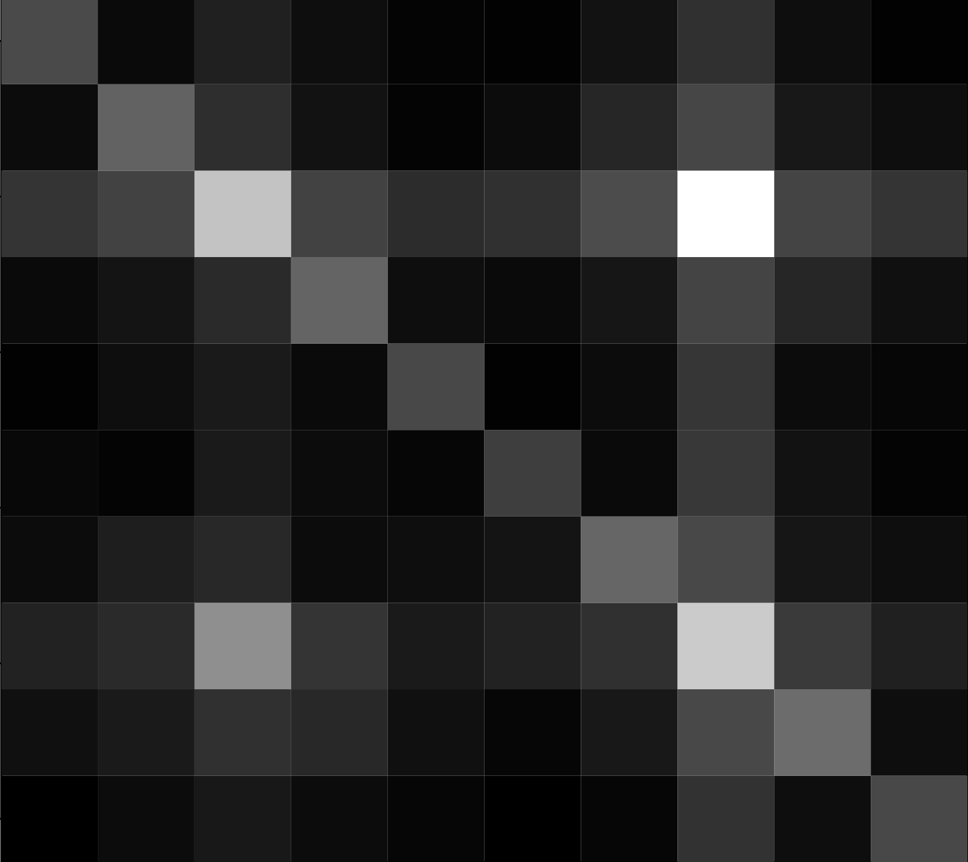
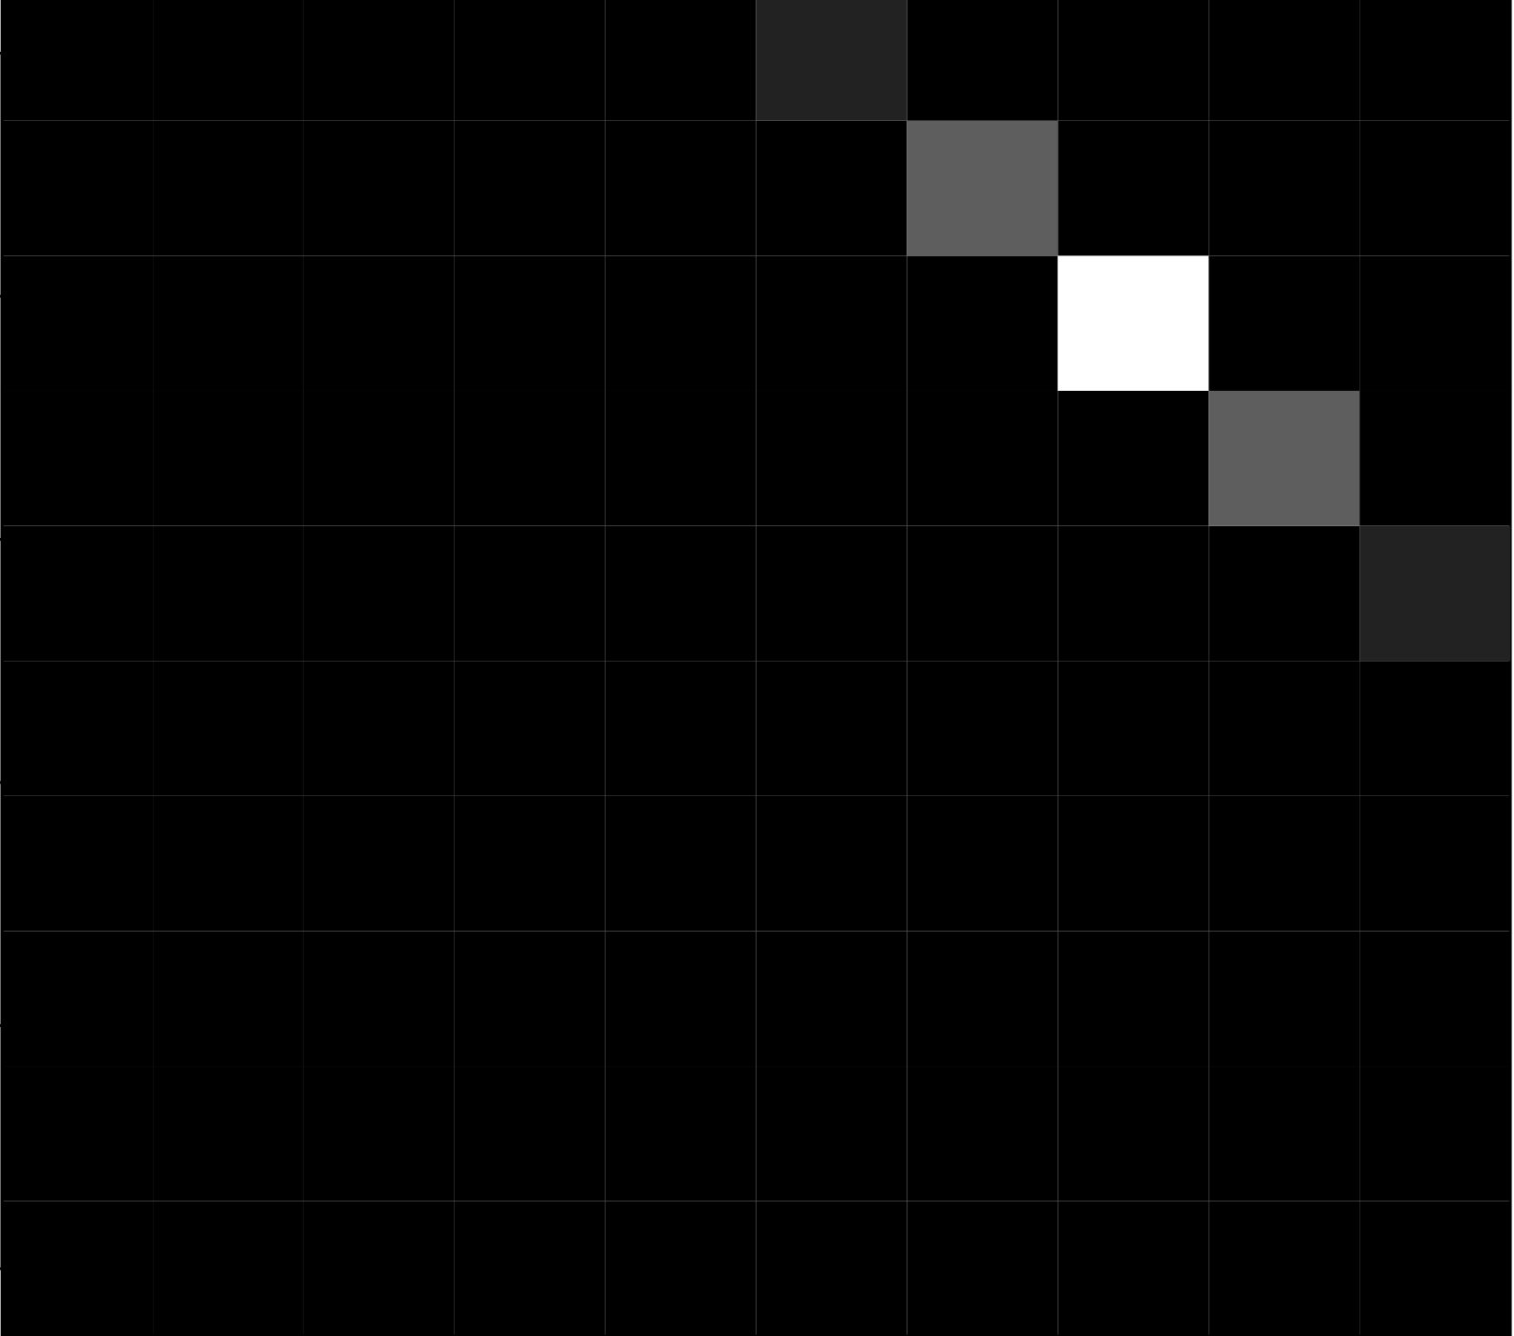
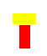

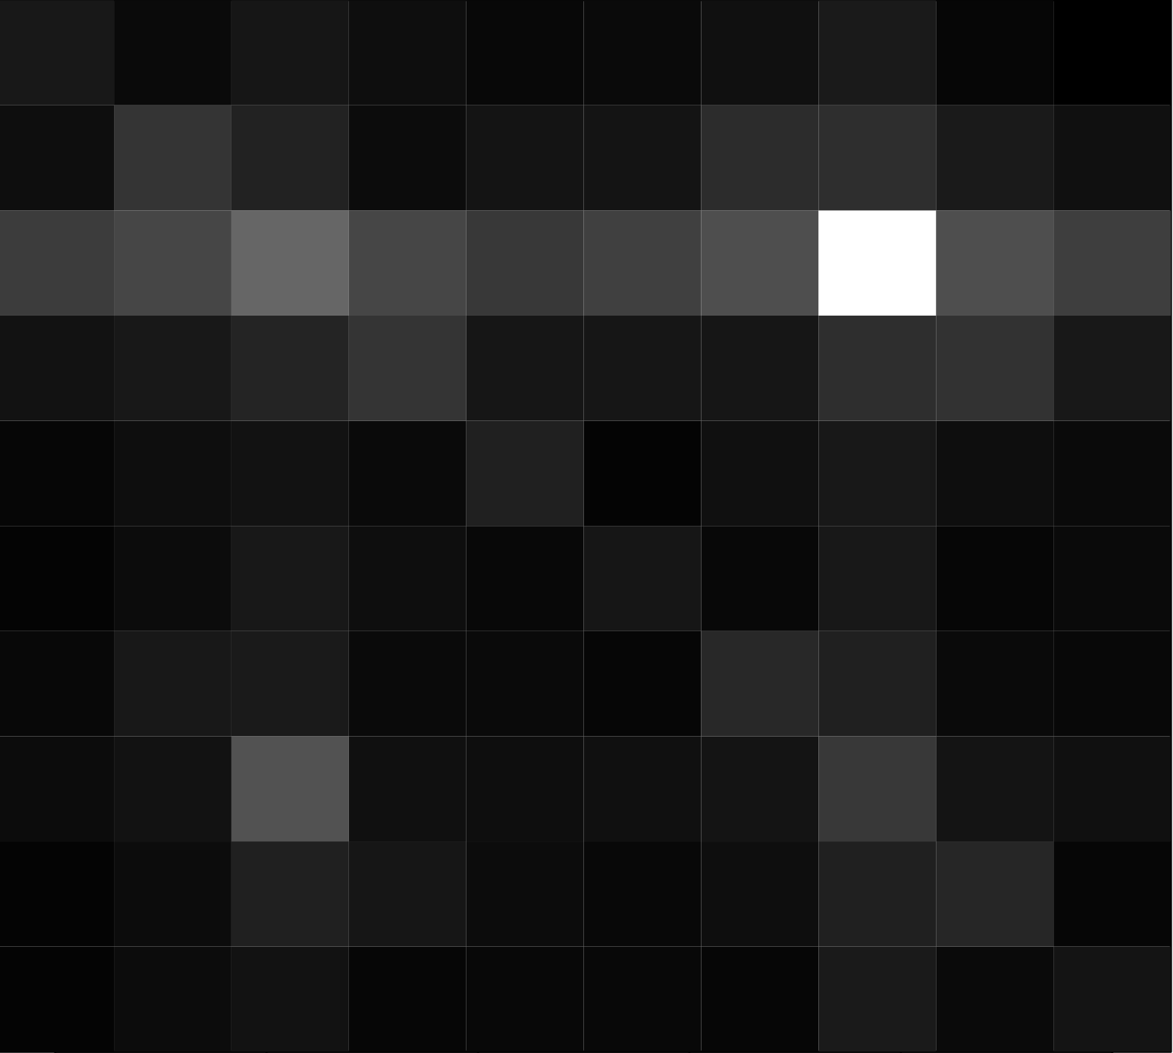
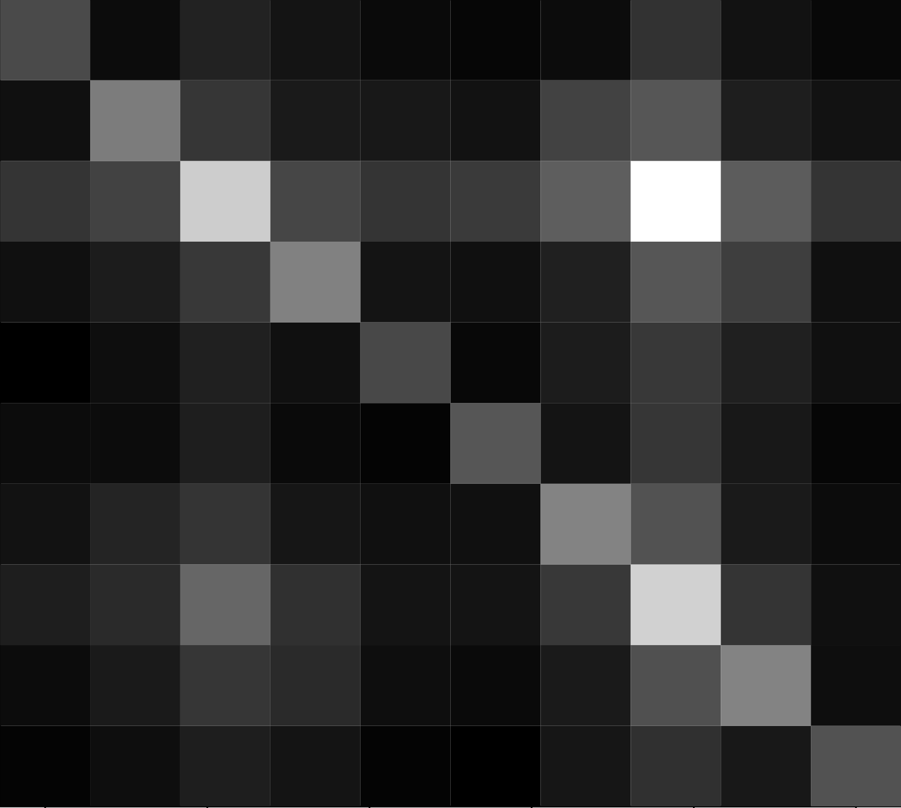
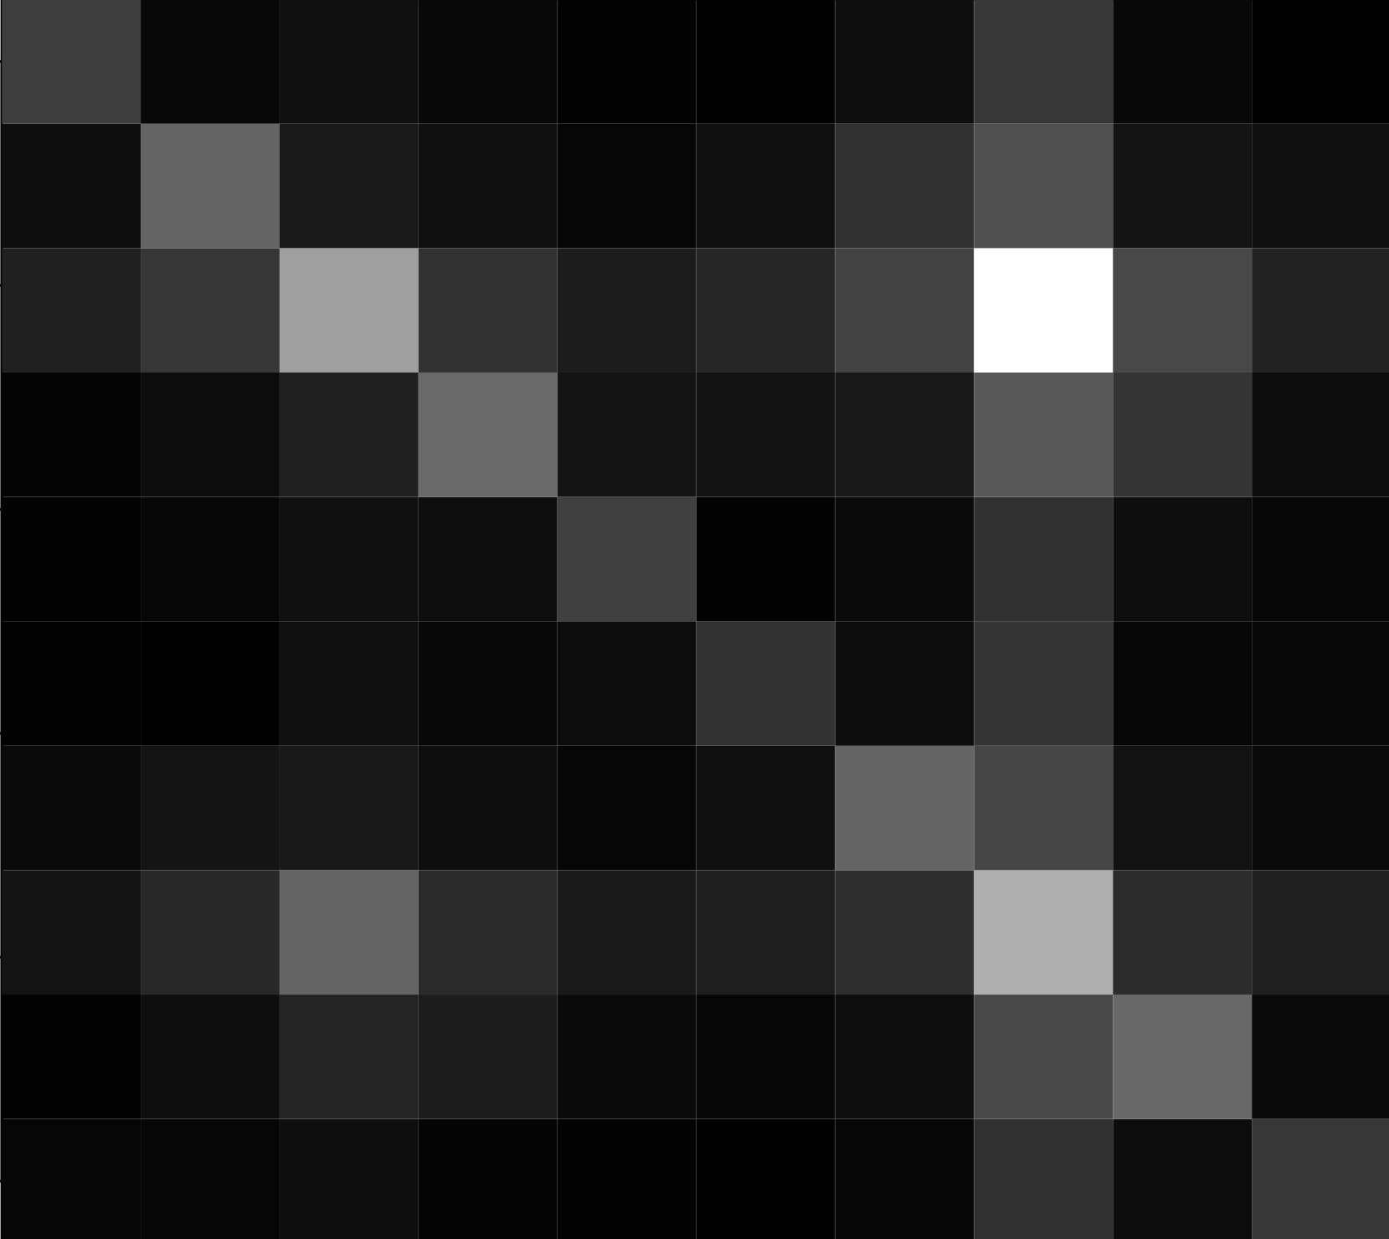
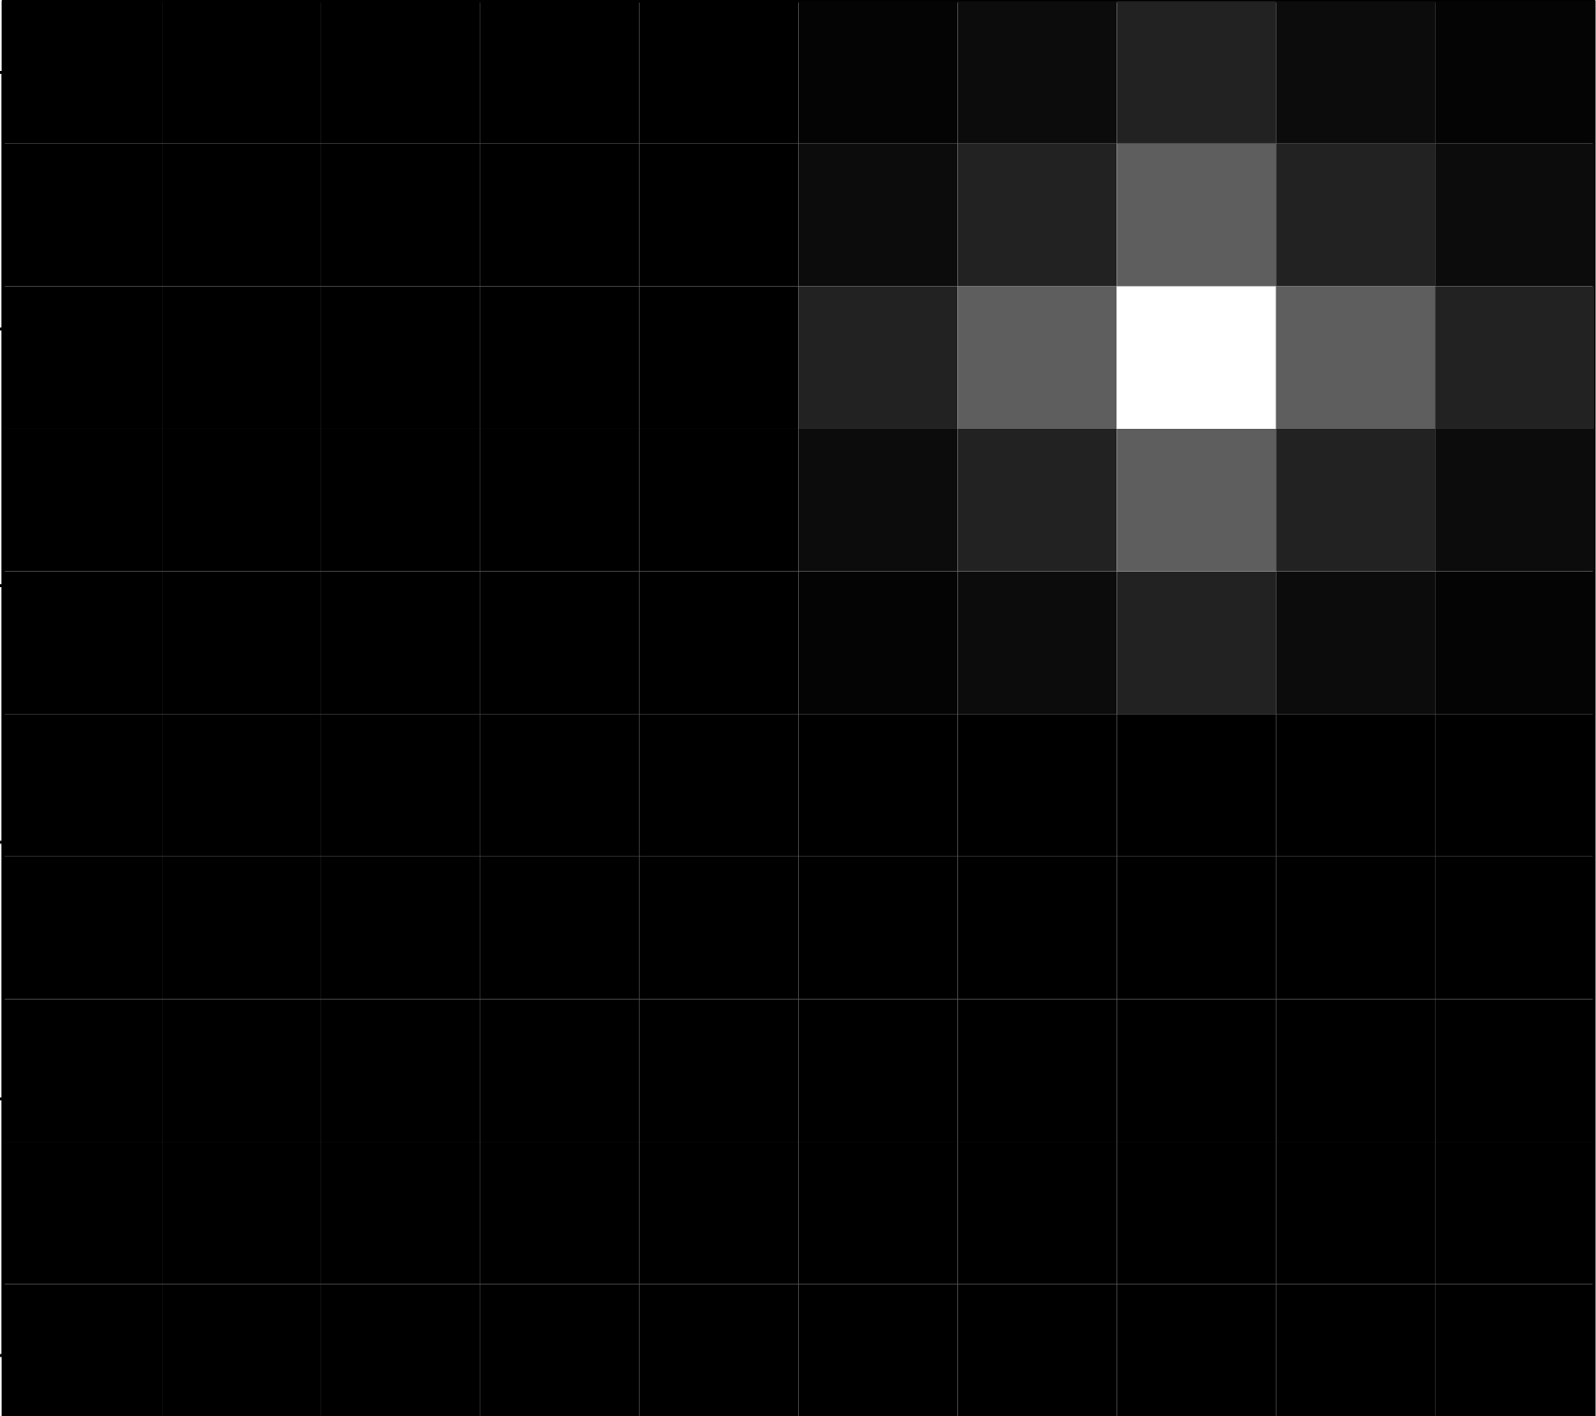

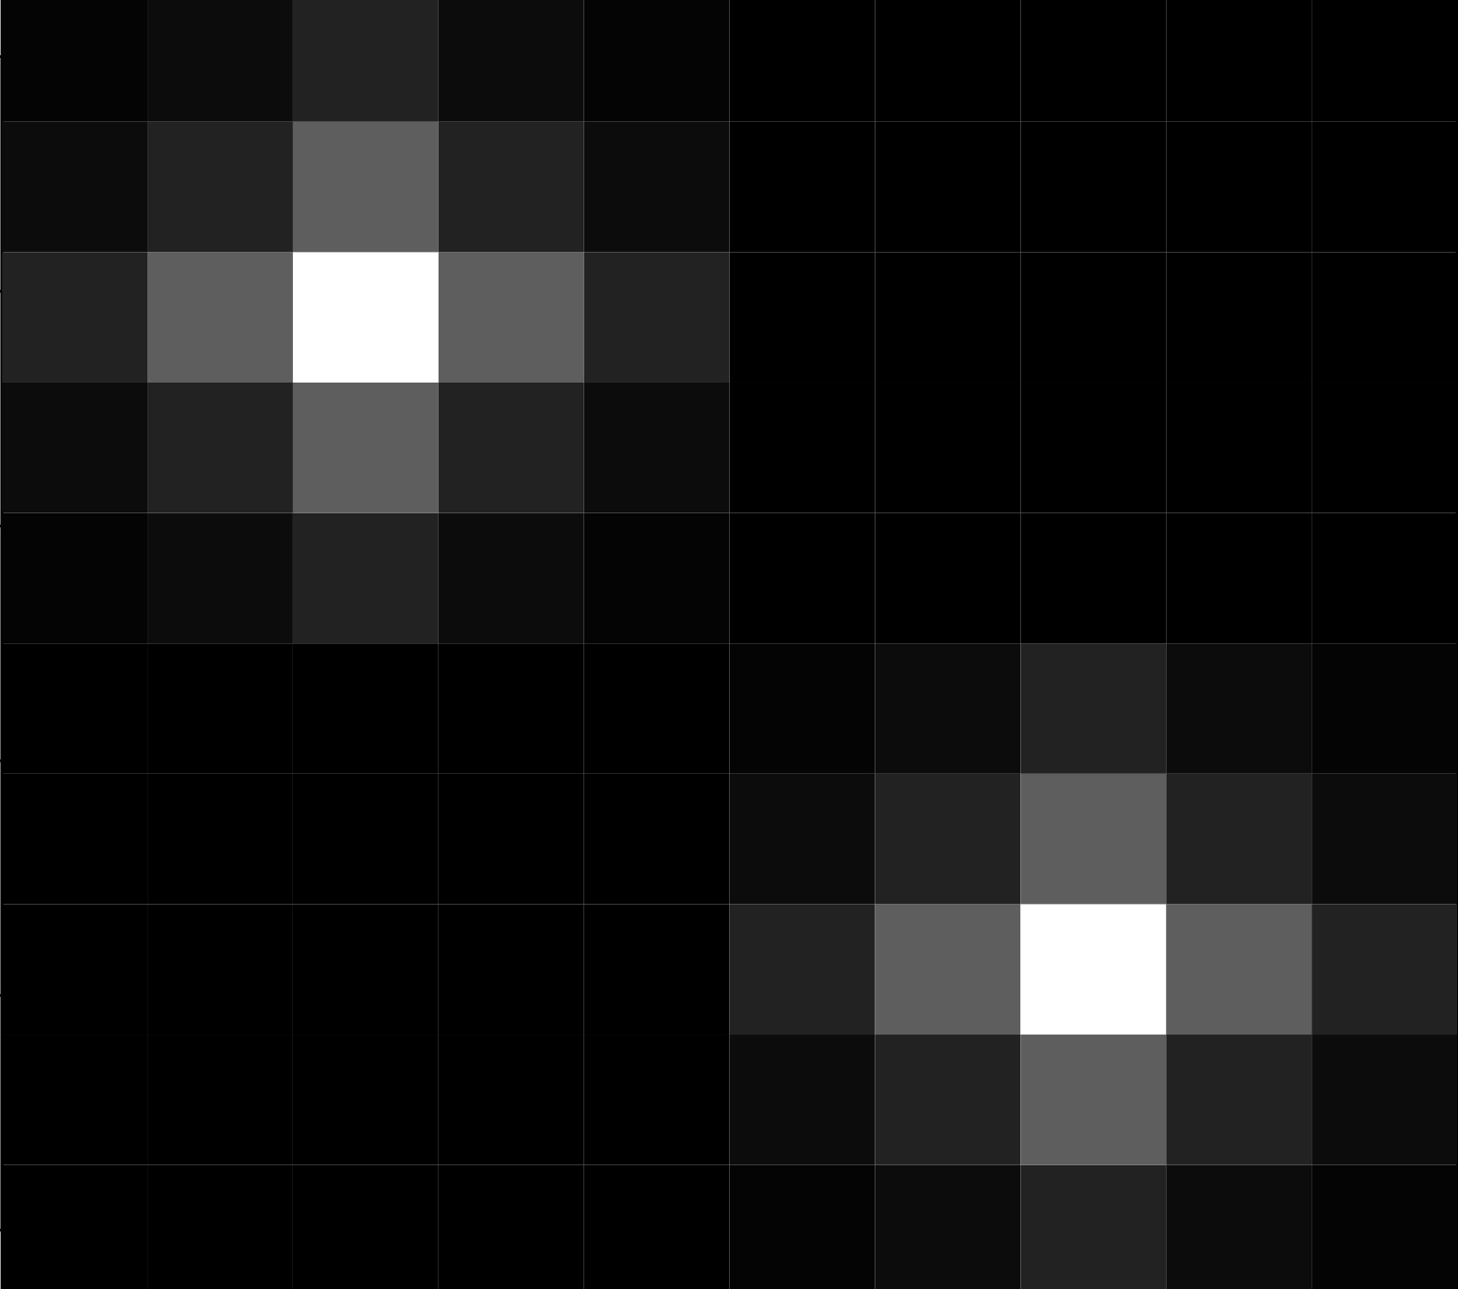

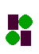

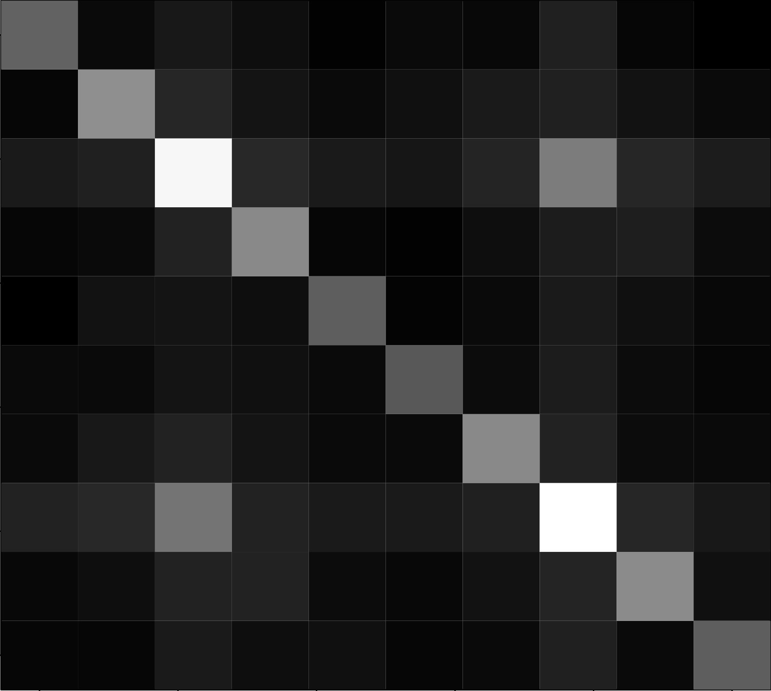
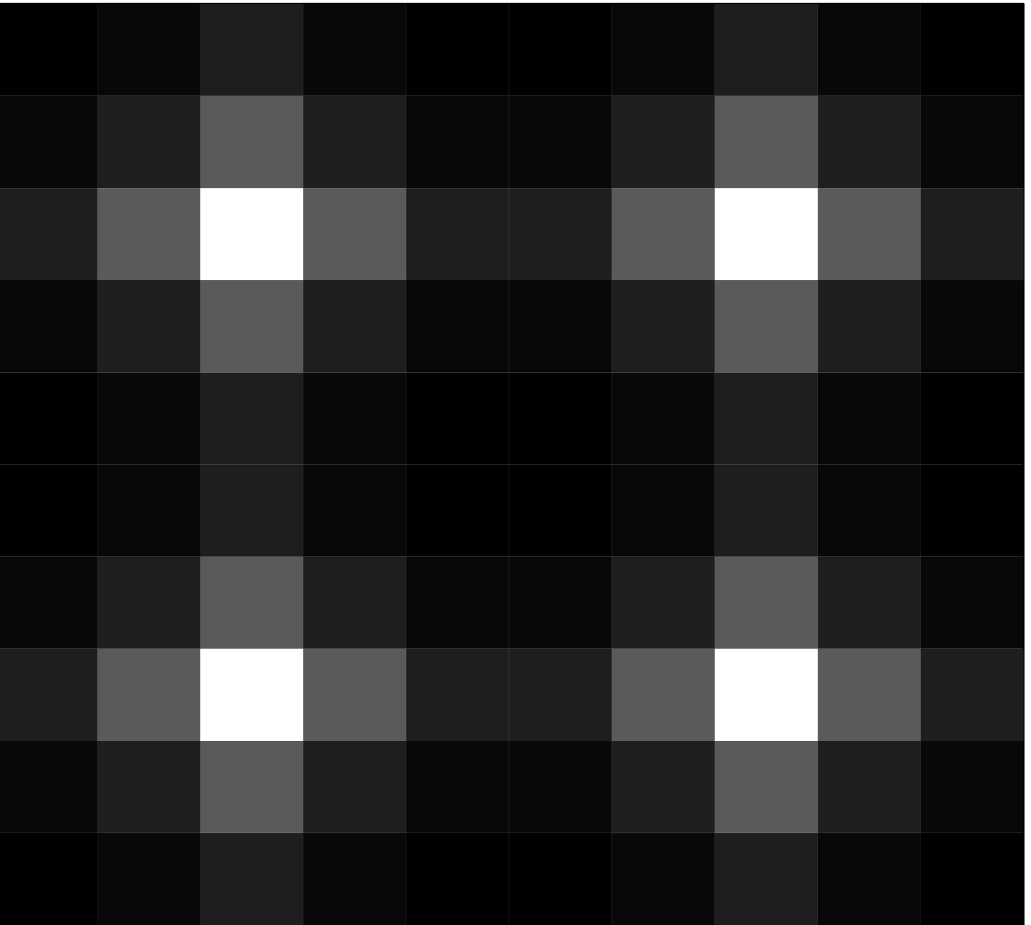




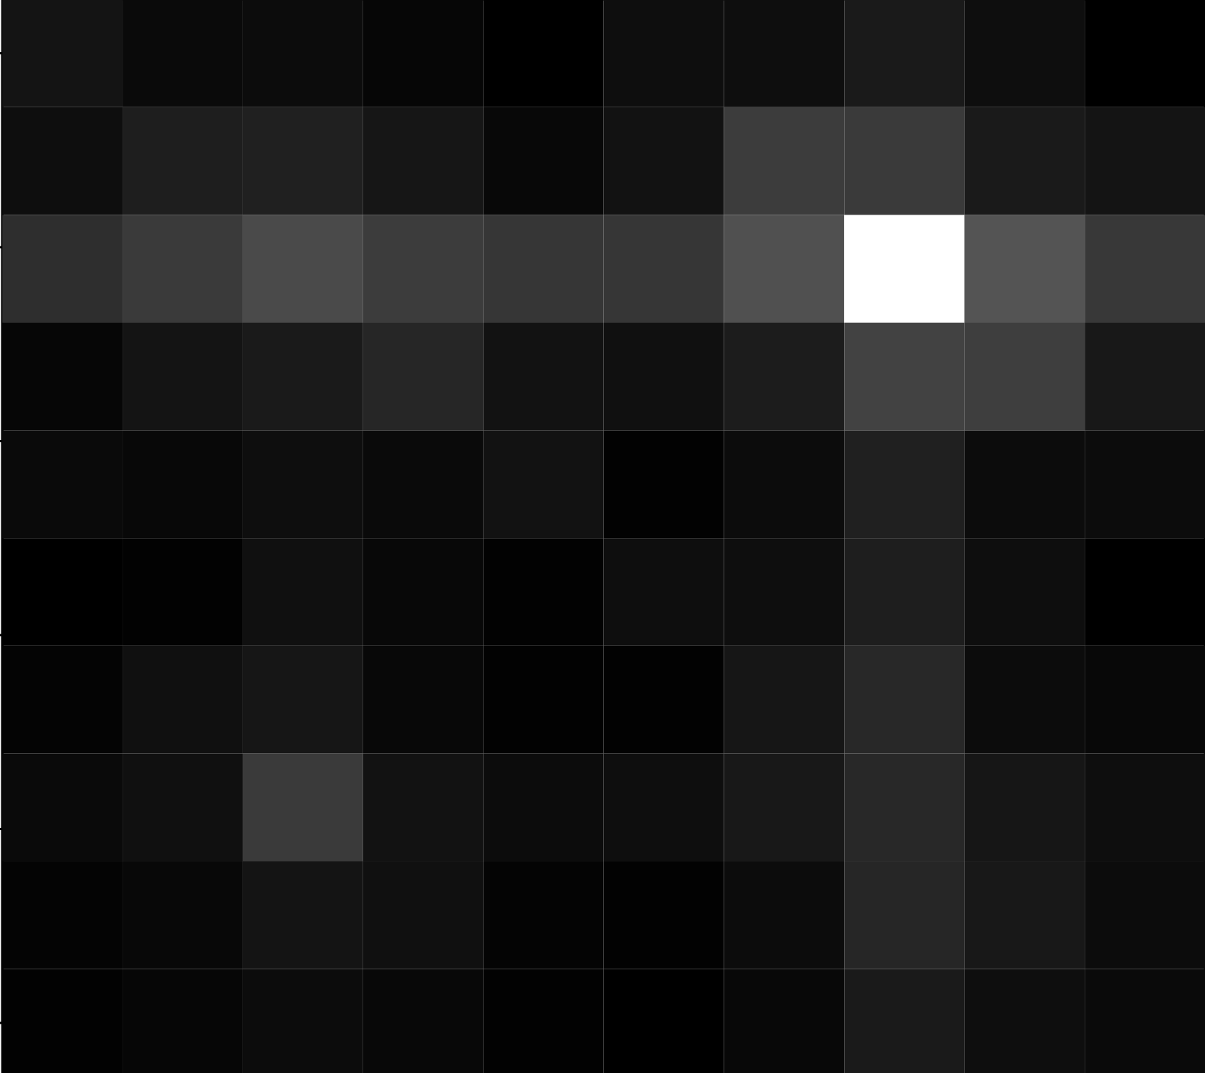
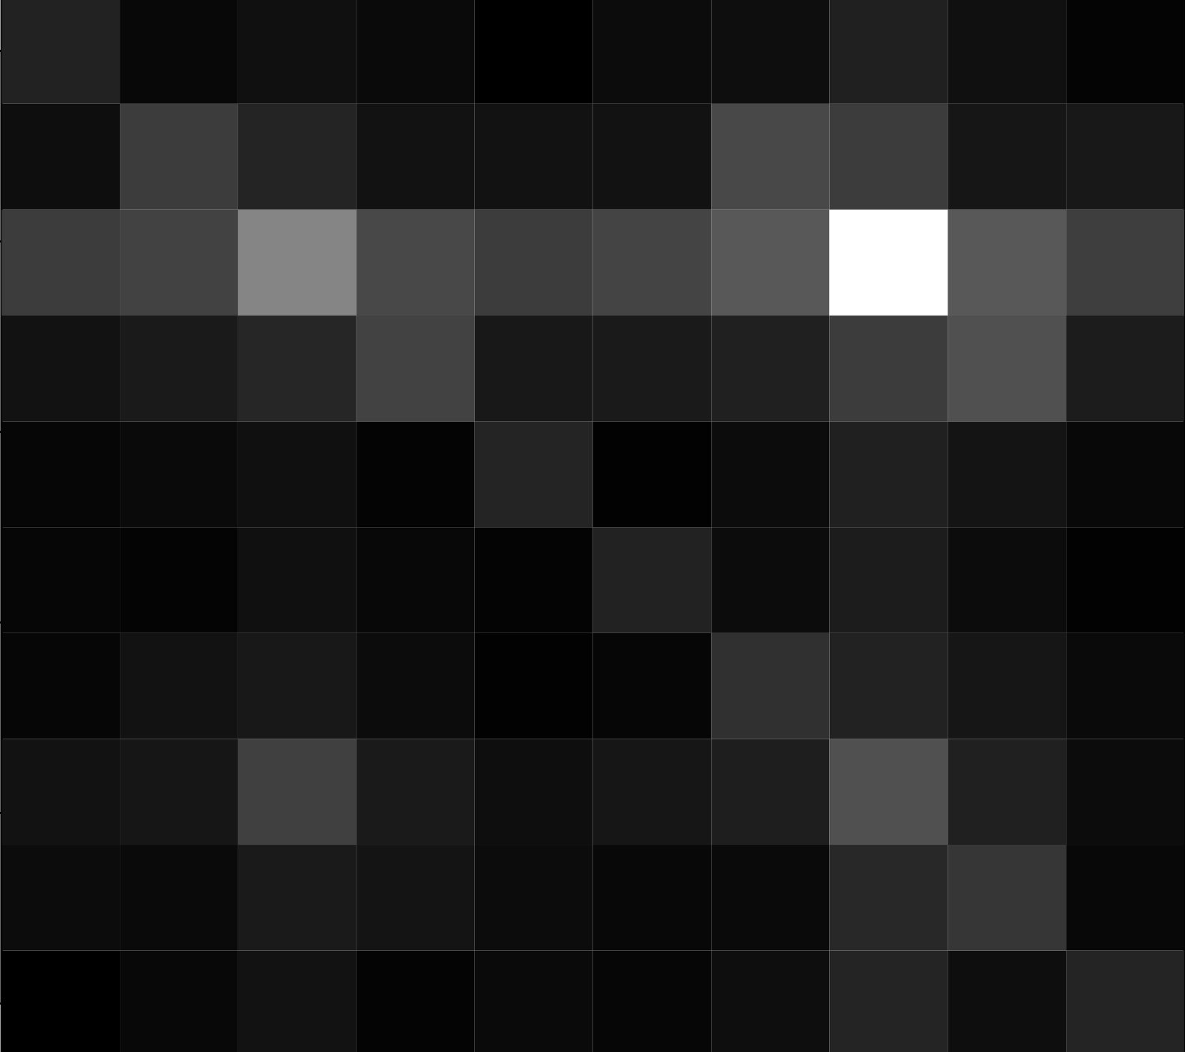
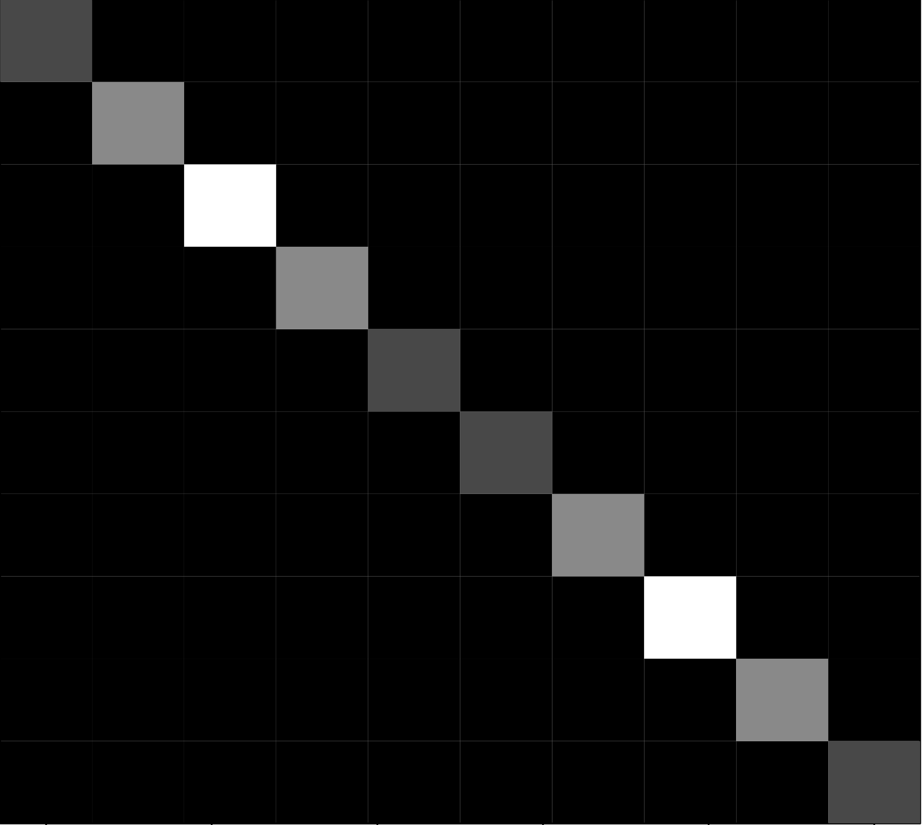



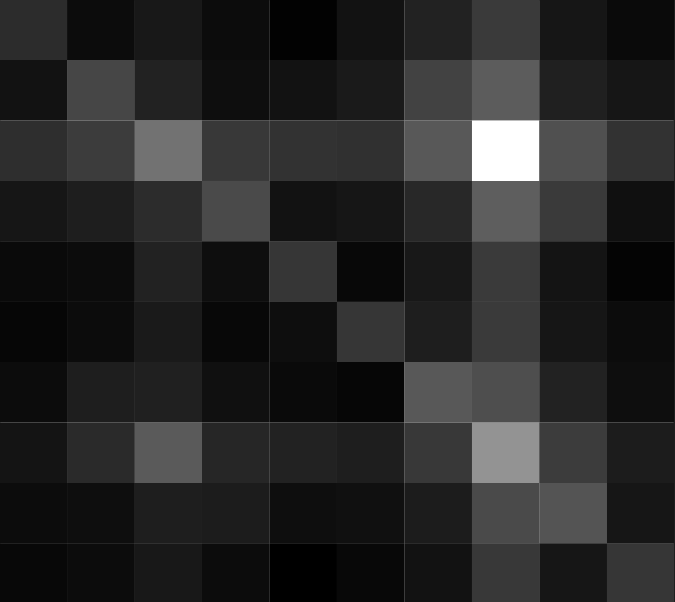
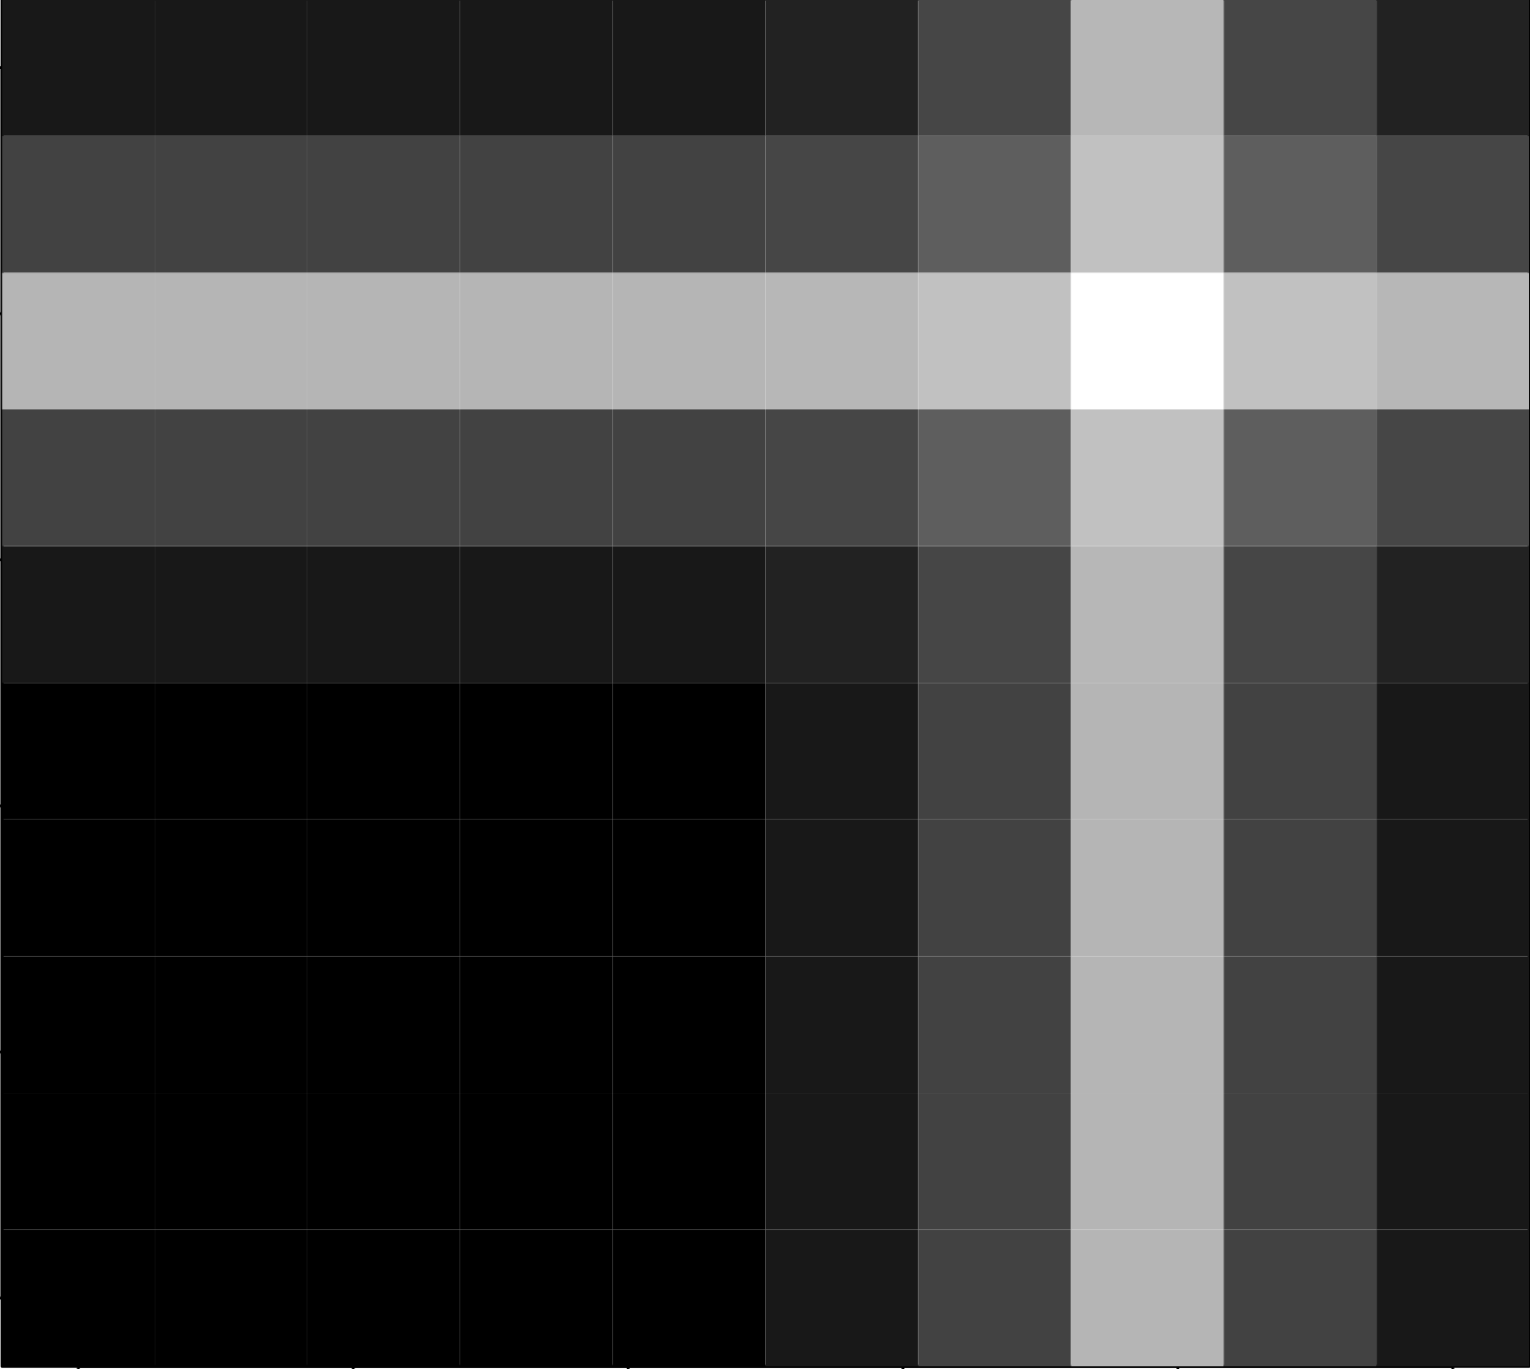
Trial procedure
Fixation point (400 ms) followed by cued object array (100 ms)
Response collection
color and part order randomized
Responses by object type
Response patterns from sampling
I
Target and adjacent distractors
Sample whole objects
Reports of part A color for part A
I
Sample both parts
(or one part and correct color)
Reports of part B color for part A
I
Reports of part A color for part B
Reports of part B color for part B
Sample two colors
Responses for each object type are displayed as image matrices. The brightness of each cell indicates the reported proportion of responses of the color of each object part by the actual location/part of the reported color. A variety of object types were tested between subjects, with ~25 subjects per object type. Idealized response patterns obtained from sampling at different levels of the stimuli are plotted on the right.
Sample one color
(respond twice)
Sample one part
(guess other)

